Slide 1
Furfural TPD on Pt(100)-hex
Subgroup Meeting 8/17/2016
Emanuel Scoullos

Slide 2
Motivation
Biofuels are viewed as a renewable source of energy
Need to increase energy density and stability of bio-oils
Catalytic Hydrodeoxygenation
Furfural is a major component of bio-oil

Slide 3
A brief literature review…

Slide 4
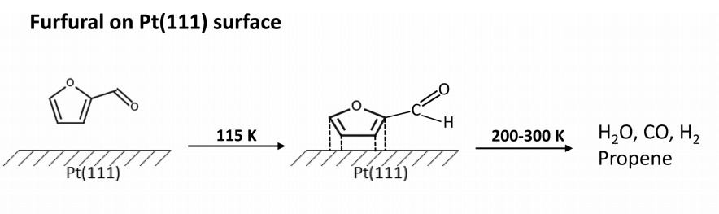
Proposed adsorption from HREELS study and DFT (separate paper)
D. Shi and J. Vohs. ACS Catalysis. (2015).

Slide 5
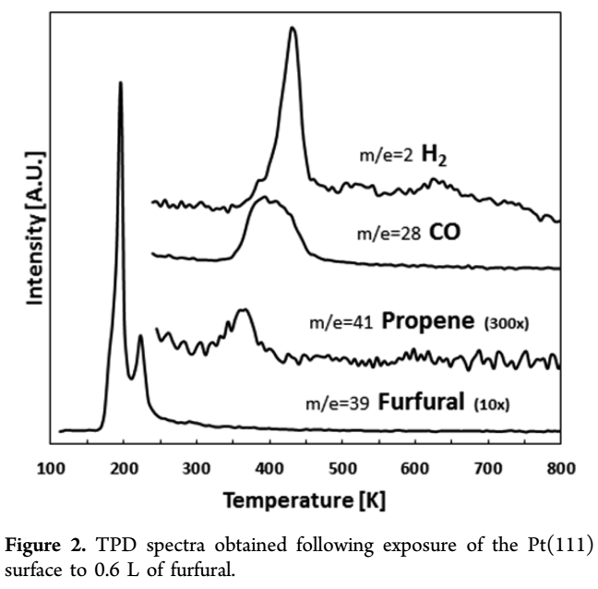
D. Shi and J. Vohs. ACS Catalysis. (2015).

Slide 6
My proposed pathway for furfural decomposition on Pt(100)-hex

Slide 7
Almost the same

Slide 8
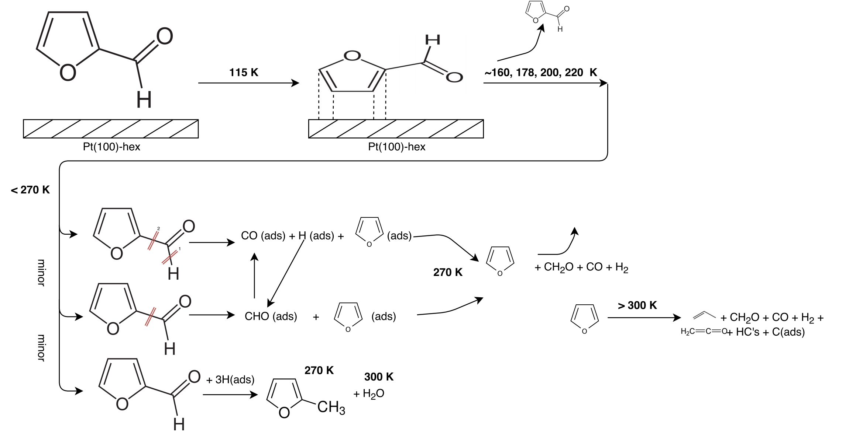
Almost the same

Slide 9
Almost the same

